Slide 1
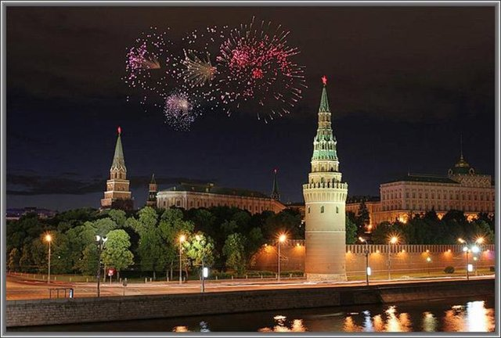
What do you know about moscow?

Slide 2
Famous Muscovites | 100 | 200 | 300 | 400
History of Moscow | 100 | 200 | 300 | 400
Buildings | 100 | 200 | 300 | 400
Monuments | 100 | 200 | 300 | 400

Slide 3
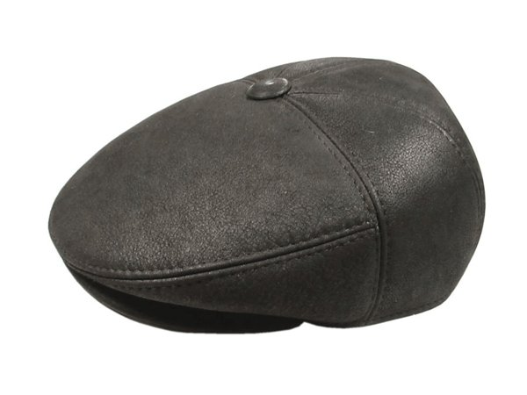
He was mayor of Moscow for 18 years. He often appeared in public in a cap which became a part of his image.

Slide 4
He was born in Moscow in 1799. His first poem was published when he was 15. Now he is considered to be the greatest Russian poet. What’s his name?

Slide 5
He was born at the Mariinsky Hospital for the poor in Moscow. He is known for his novels Crime and Punishment and The Brothers Karamazov. What’s his name?

Slide 6
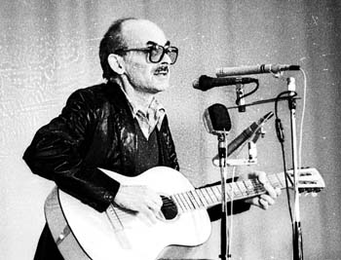
This singer, bard and poet is famous for his songs about the Arbat. What’s his name?

Slide 7
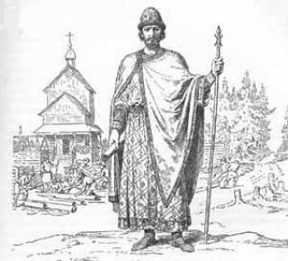
This prince founded Moscow in 1147.

Slide 8
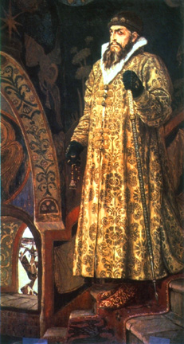
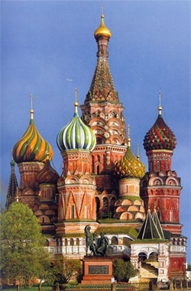
There is a legend that Ivan the Terrible ordered to blind St. Basil’s architects. Why?

Slide 9
He was expecting a deputation with the keys from the city, as had been the case in Berlin, Vienna, Amsterdam and Rome. Time passed but no deputation was in sight. Moscow was empty. He didn’t believe it at first. “Moscow deserted? Incredible!”
What’s his name?

Slide 10
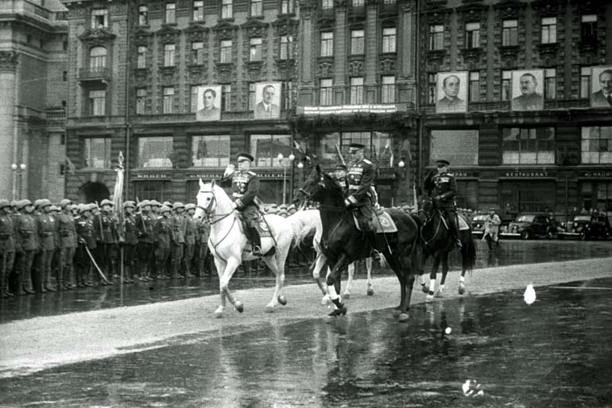
Can you name the two people on the horses? When did this parade take place?

Slide 11
You can see this building on a 100 rouble note. What is it famous for?

Slide 12
It is the tallest tower in Europe and a member of World Federation of great towers.

Slide 13
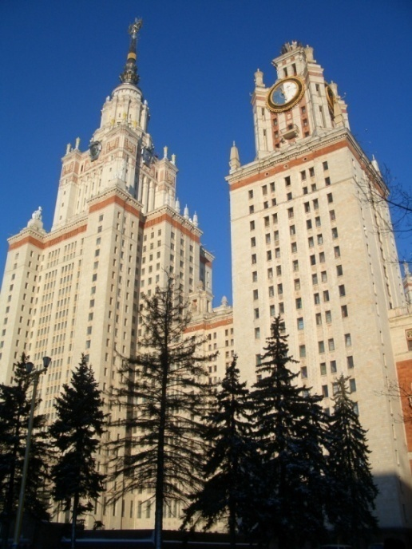
It was the tallest building in Europe when it was built in 1953. It has got 36 floors with over 5000 rooms, 33 km of corridors.

Slide 14
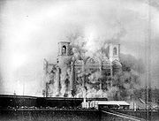
This largest in Russia cathedral was demolished in 1931 and reconstructed in the 1990s.

Slide 15
When this monument was erected on the Moskva river in 1997a lot of people protested, saying it was ugly.

Slide 16
It was the first monument to a poet in Russia.
Can you name this monument?

Slide 17
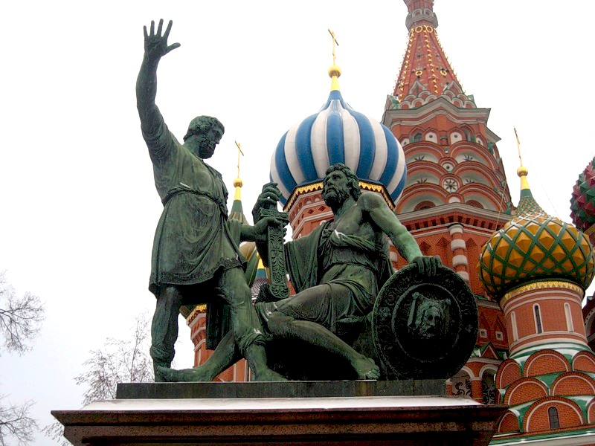
What words are inscribed on the pedestal of this monument?

Slide 18
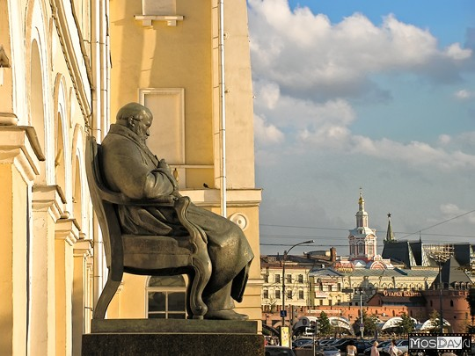
Monument to what Russian playwright can you see beside the Maly Theatre?

Slide 19
Places | 100 | 200 | 300
Moscow in Art | 100 | 200 | 300
Sports | 100 | 200 | 300
Streets | 100 | 200 | 300

Slide 20
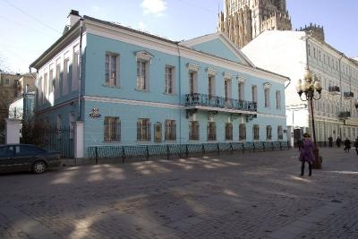
What Russian poet lived in this house in the Arbat?

Slide 21
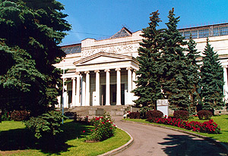
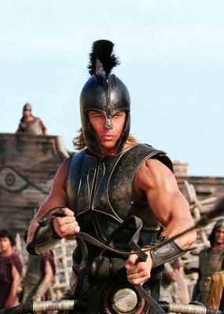
In this museum you can see the legendary treasures of Troy.

Slide 22
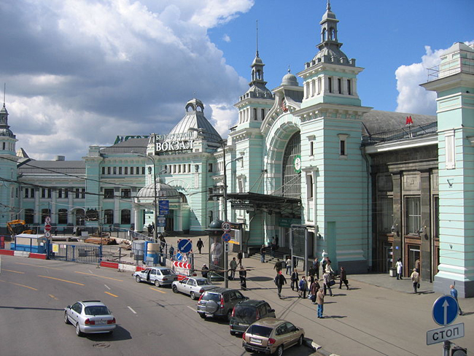
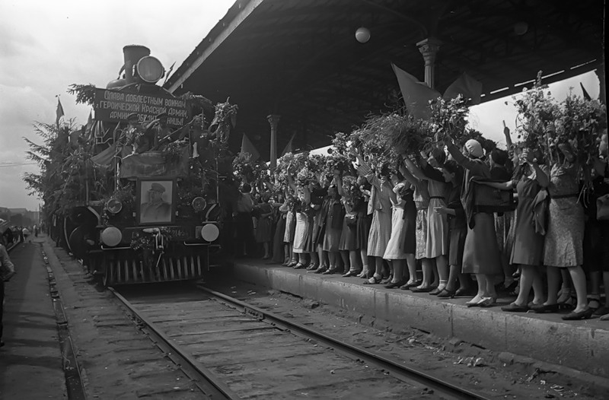
In 1945 the trains with the Russian army which captured Berlin arrived at this station. What station is it?

Slide 23
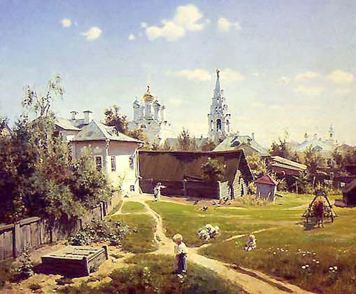
Who’s the author of the famous ‘Courtyard in Moscow”?

Slide 24
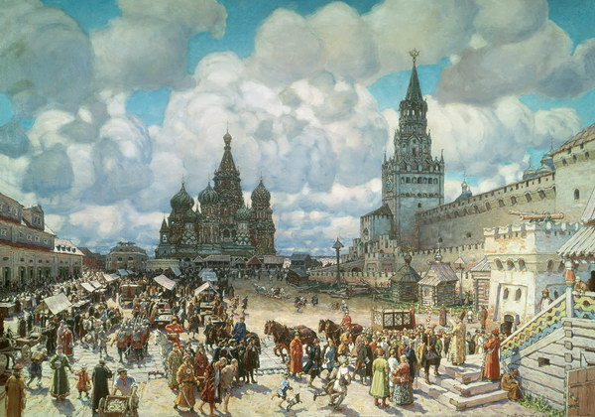
This painter specialized in the scenes from medieval Moscow. What’s his name?

Slide 25
This film was awarded an Oscar for the Best foreign language film in 1980. US President Ronald Reigan wathed it several times to understand ‘the Russian soul’

Slide 26
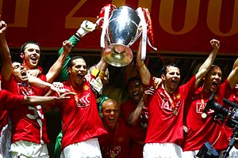
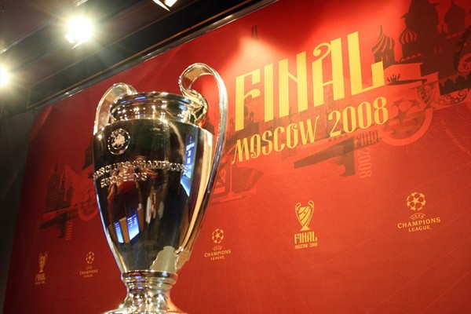
The Champions League Final in 2008 was played at this stadium. Manchester United played against Chelsea and won. What is the name of the stadium?

Slide 27
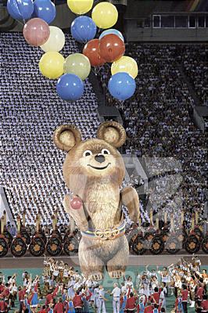
When did Moscow host the summer Olympic games?

Slide 28
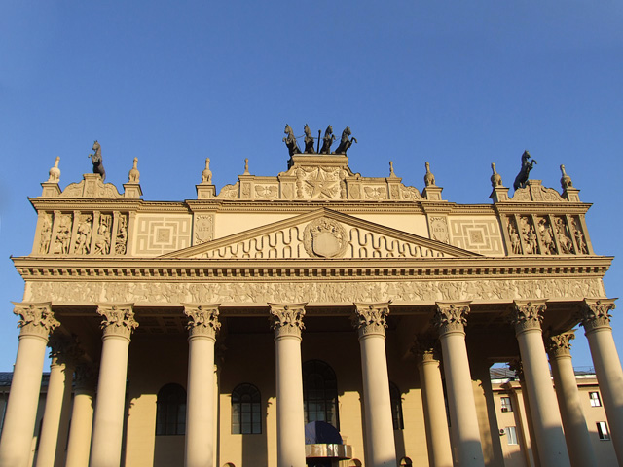
What sporting events are held at this place in Moscow?

Slide 29
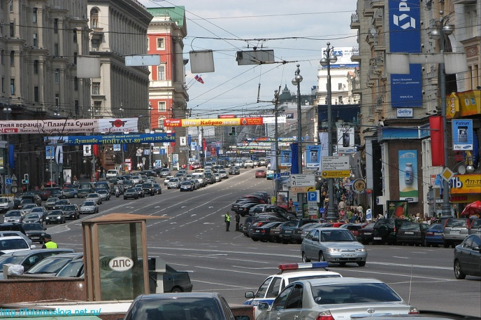
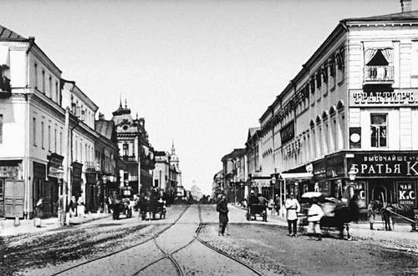
This street existed as early as in the 12 century and it connected Moscow and Tver. Now it’s the most expensive shopping street in Moscow.

Slide 30
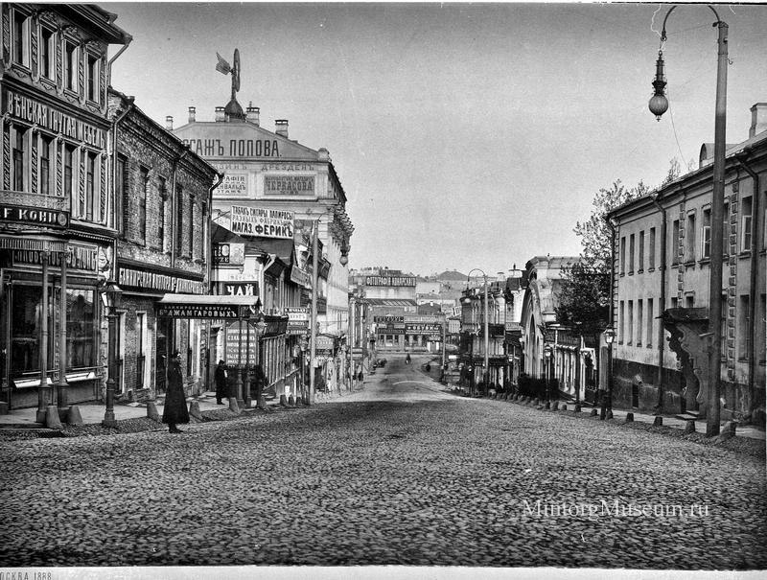
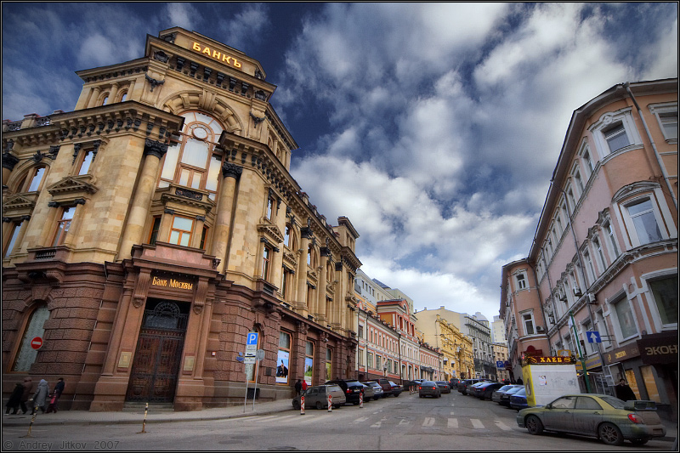
Since the 18th century it has been the street of fashion and expensive clothing.

Slide 31
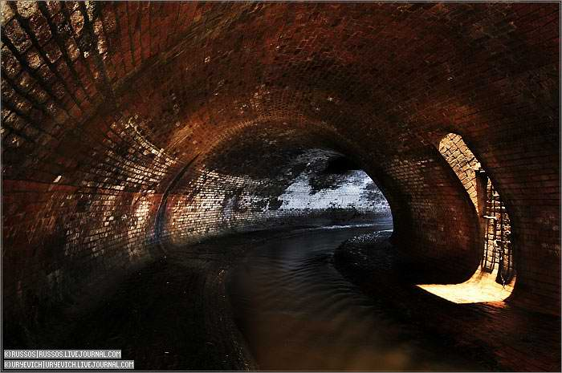
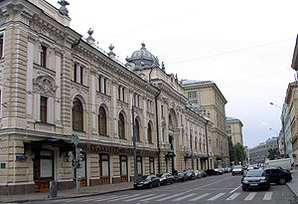
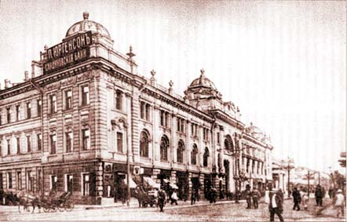
This street was paved over an underground river in 1819. The river gave the name to this street.

Slide 35
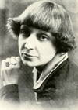
Clouds - all around,
Cupolas - around,
Over all Moscow
Many arms are wound!
I am lifting you, my best burden you
Oh my little tree
Flying weightlessly!
Who is the author of these lines about Moscow?

